Slide 1
FIT1047 Week 6&7 Forum
Introduction to Computer Systems, Networks and Security

Slide 2
Learning Outcomes
At the end of this forum, you will be able to:
1. Name and describe the functions of the different layers of the Internet Model
2. Explain the importance of protocols and standards for the Internet Model
3. Identify different application architectures
4. Understand and analyze the HTTP application layer protocol
5. Understand how e-mail is sent using the SMTP, POP and IMAP protocols
6. Understand the difference between UDP (connectionless) and TCP (connection-oriented) transport layer protocols

Slide 3
Network Components
List down the essential components of a network.

Slide 4
The Internet
Define the Internet.

Slide 5
Protocol and Layering Architecture
Elaborate the importance of protocol and layering architecture in networking.

Slide 6
Layer abstraction in TCP/IP model
Briefly discuss the layers of abstraction in TCP/IP model and their addresses

Slide 7
Layer abstraction in OSI model
Briefly discuss the layers of abstraction in OSI model

Slide 8
Message Encapsulation and Protocol Data Unit (PDU)
Define message encapsulation and list down the PDU for all layers of TCP/IP model.

Slide 9

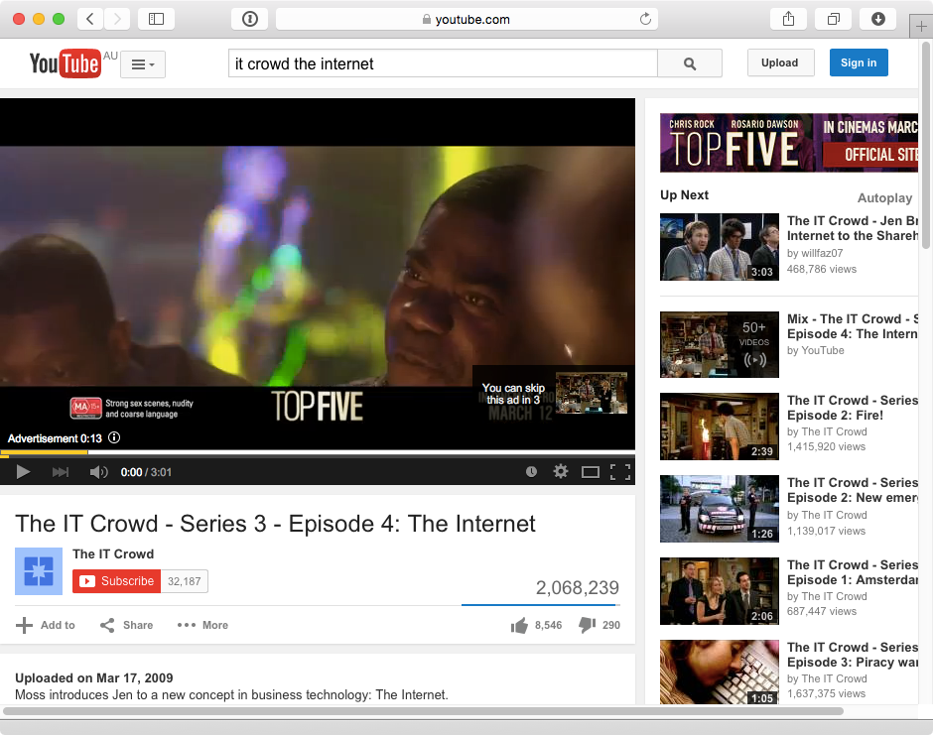
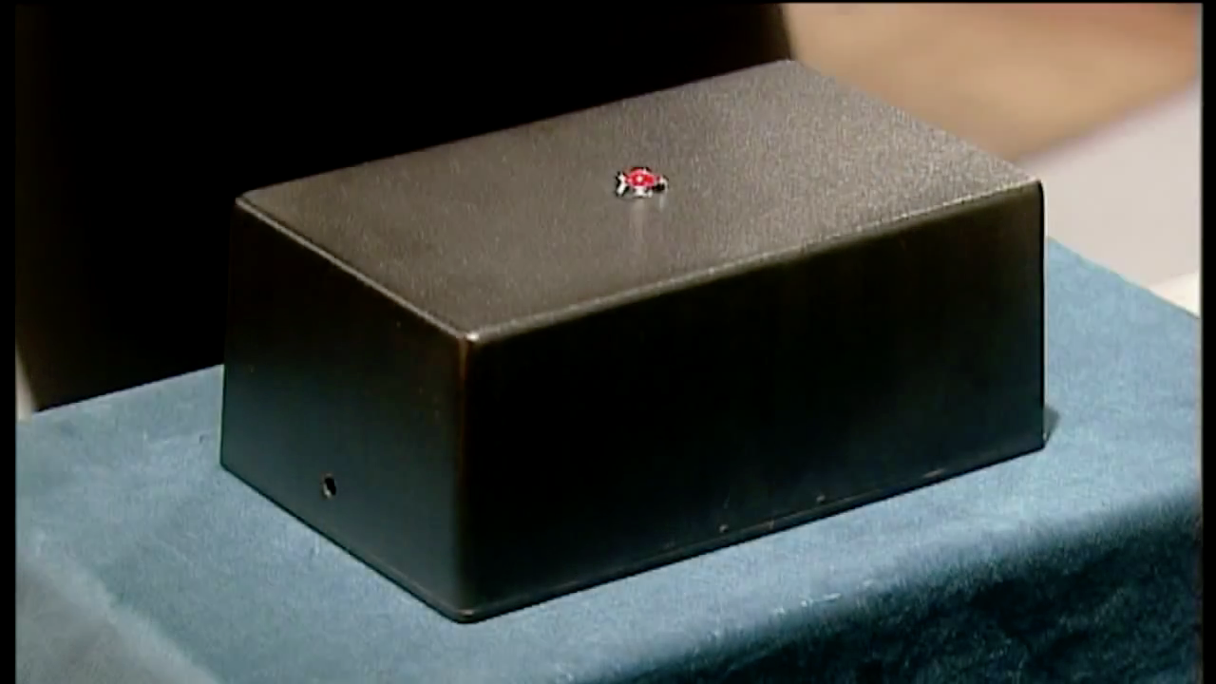

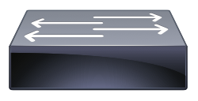

Abstraction of Layers
Briefly discuss the following diagram
Switch
Router
Switch

Slide 10
Application Layer – Application Architectures
Describe the application architecture and list down six types of architectures.

Slide 11
Application Layer – WWW, HTTP, HTML, URL
Briefly describe WWW, HTTP, HTML, and URL.

Slide 12
Application Layer – HTTP Session
Briefly describe an HTTP session. HTTP is a stateless protocol, how HTTP keeps track of the users’ browsing history?

Slide 13
Application Layer – SMTP
Briefly describe how SMTP is used for two-tier and three-tier mail.

Slide 14
Application Layer – MIME
What is the purpose of using MIME in email?

Slide 15
Transport Layer – TCP vs UDP
Compare and contrast the two important transport layer protocols, TCP vs UDP

Slide 16
Transport Layer - Addressing Application
List down the main functionalities of transport layer.

Slide 17
Transport Layer - Flow and Error Control
Explain how TCP ARQ works for the three phases of a TCP session.

Slide 18
